Slide 1
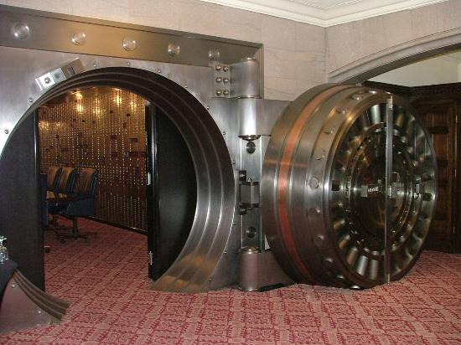
SQL Server Security Architecture Decomposed
Presented by Ayman El-Ghazali
Sr. DBA and Developer
at The American College of Cardiology

Slide 2
Agenda
SQL Server Security Top-Down Overview
Ports (SQL Server, Browser, DAC, SSAS)
Server Logins
Server Roles (Custom Roles New for 2012)
Logon Triggers
Database Schemas
Database Users
Database Roles
Database Cross Ownership Chaining
Contained Databases (New for 2012)
SQL Server Best Practices Analyzer

Slide 3
SQL Server Security Overview
Firewall Ports
Active Directory
Users/Groups
Operating System
Server Logins
Server Roles
Proxies
EndPoints
Logon Triggers
SQL Instance
DB Users
DB Roles
Schemas
Application Roles
Database

Slide 4
SQL Server Security Overview
Schemas
Tables
Views
Stored Procs
Functions
Server Login (SQL or Windows)
Database User
Maps To
Permissions
Maps To
Maps To
Permissions
Server Roles
Permissions
Database Roles
Permissions
Jobs
DB Mail
Control

Slide 5
SQL Server Security Overview
Principals - Object that is authenticated and given access
OS - Windows Logins
Instance - Server Logins, Server Roles
Database - DB Users, DB Roles
Securables -objects that are given access to
OS - NONE
Instance - DBs
Database - Tables, views, schemas, procedures, etc
Principals are given access to securables
Visual Representation

Slide 6
Ports
Managed with Configuration Manager
SQL DB Engine - 1433 TCP
Dedicated ADMIN (DAC): 1434 TCP
SQL Server Browser 1434 UDP
SSAS – 2383 TCP
MSDTC & SSIS via SSMS - 135 TCP
Also needed for Failover Clustering
SQL Server Named Instances – by default uses dynamic ports but this can be changed.
http://technet.microsoft.com/en-us/library/cc646023.aspx

Slide 7
Server Logins
Security at the DB Engine or Instance Level
Can be of two kinds:
SQL Server Login (Only works within SQL)
Windows Login

Slide 8
Server Roles
Custom Server Roles are new for SQL 2012
Server logins are mapped to Server Roles for permissions
Roles allow giving permissions based on job function
Demo - Create Server Login and Role

Slide 9
Logon Triggers
Server Trigger that Fires during Logon
For Auditing or Logon Time Restrictions
Demo - create simple Logon Trigger

Slide 10
Database Schemas
Logical container and owner of objects such as tables, functions, stored procedures
Can create schemas to group similar objects that belong to different departments for example HumanResources, Sales, etc
Can give permissions at the schema level which helps separate permissions further
Schemas are also useful for data warehousing environments where you want to keep the same object names

Slide 11
Database Users
A login at the database level
Must be mapped to a server login otherwise the DB User is considered "Orphaned"
Server Login
(SID)
DB User

Slide 12
Database Roles
Same as server roles but at the Database level
Could always create custom roles
Demo - Create DB User, Role, and Schema

Slide 13
SQL Orphanage
SQL Server Logins have SIDs (Security ID)
This SID is created when the Login is created and is unique on each server because it is randomly generated
Problems occur when you move databases to other servers since they may already have the same SQL Login, or if it is created it will have a different SID
So the DB User is no longer mapped to the Login

Slide 14
Fixing Orphaned Users
Use sp_change_users_login
Use sp_help_revlogin - for many logins that need to be fixed, especially useful for migrations
Demo - Create Orphaned user and fix

Slide 15
Database Cross Ownership Chaining
Disabled by default
Can be enabled at DB or Instance level
"When an object is accessed through a chain, SQL Server first compares the owner of the object to the owner of the calling object. This is the previous link in the chain. If both objects have the same owner, permissions on the referenced object are not evaluated."
http://msdn.microsoft.com/en-us/library/ms188676(v=sql.105).aspx

Slide 16
Database Cross Ownership Chaining
At the Database Level
Scenario 1 - Green and Red have given Permission
Scenario 2 - Green has given Permission
View
Table 1
Table 2
Table 3
Color signifies object ownership
Table 4

Slide 17
Database Cross Ownership Chaining
(Instance Level)
At the Instance Level (between DBs)
Scenario - Green has given Permission on DB1 only
Ownership chaining is enabled between DBs then permissions will not be checked since Green owns objects
Database 1
Database 2
View
Table 1
Table 2
Table 3
Color signifies object ownership

Slide 18
Database Cross Ownership Chaining
(Instance Level)
What if Orange is DB_Owner on DB1?
Can create Green user, create a view owned by Green user that references tables in DB2
Evil Orange is malicious and thus gains access
Database 1
Database 2
View
Table 2
Table 3
Frowning signifies evil intent and spoofing

Slide 19
Contained Database Security
Database user has no Login on server therefore cannot have orphaned users
Database is considered an independent working entity that is "contained" and separate from the server
**WARNING**
Contained DB users will have access to databases with guest user enabled

Slide 20
Best Practices Tool
Microsoft Baseline Configuration Analyzer
http://www.microsoft.com/en-us/download/details.aspx?id=16475
SQL 2012 Best Practices Analyzer
http://www.microsoft.com/en-us/download/details.aspx?id=29302

Slide 21
Other Security Topics to consider
Auditing
TDE (Transparent Data Encryption)
Policy Based Management (Sort of)
Proxy accounts and Linked Servers
And of course SQL Injection!

Slide 22
Q&A
Easiest way to contact is via LinkedIN
www.linkedin.com/in/aymansqldba
Code and slides available at my website:
www.thesqlpro.com

